Slide 1
Project 4
Predicting Stock price
By alex lu

Slide 2
Problem
Predicting today’s stock price based on past 7 days open, close, low, high and volume data.
As an example, we use apple stock in our modeling. We will predict apple stock’s closing price based on past 7 days’ open, close, low, high and volume data.

Slide 3
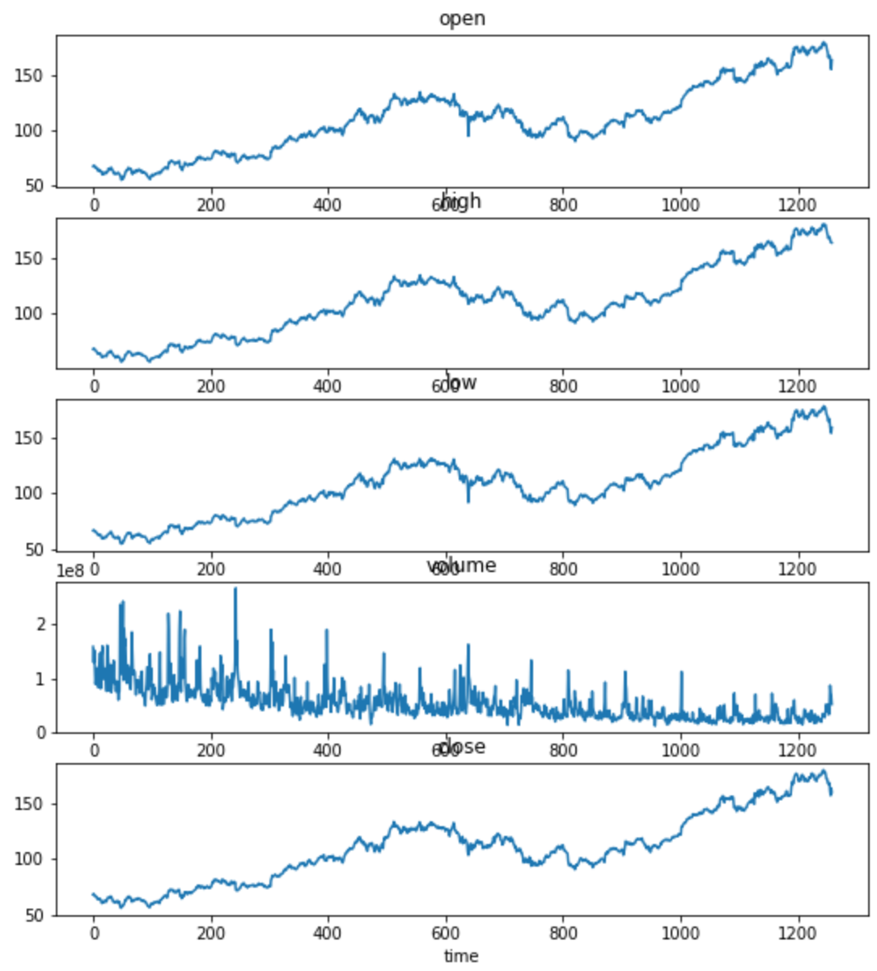
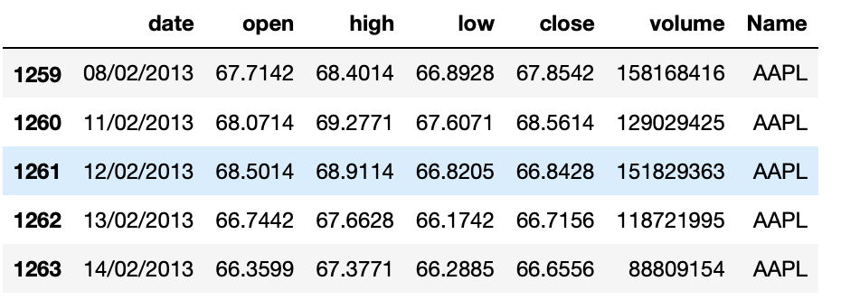
Data
Raw Data: source Kaggle. Very clean. First glance makes sense.

Slide 4
Solution
Long Short Term Memory (LSTM) model
Intuition: a technical trader often takes consideration of previous days trading momentum when making a decision to buy or sell on any given day. These momentum are reflected in past historic price action: What were the volume in the stock? Was it making higher highs or lower lows? Was closed at bottom of the daily range or top?
LSTM is a perfect model for solving such problem given its recursive conveyor belt nature.

Slide 5
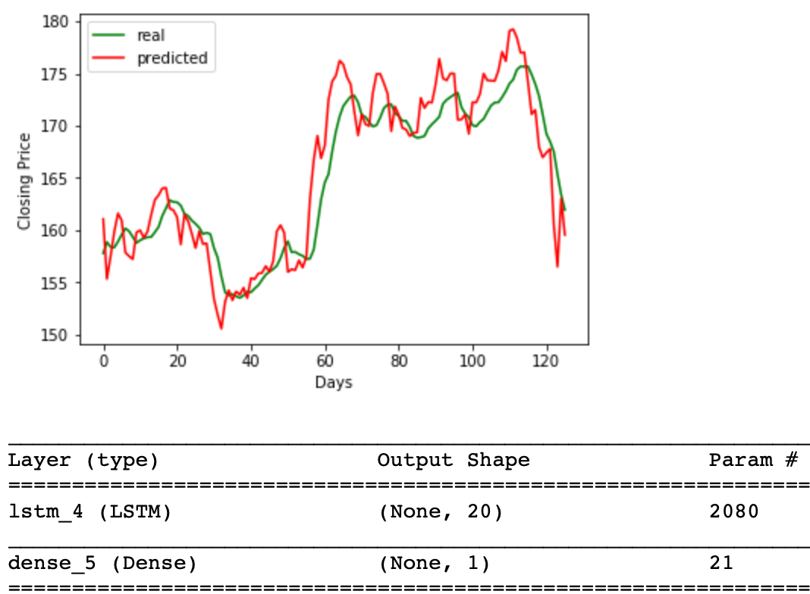
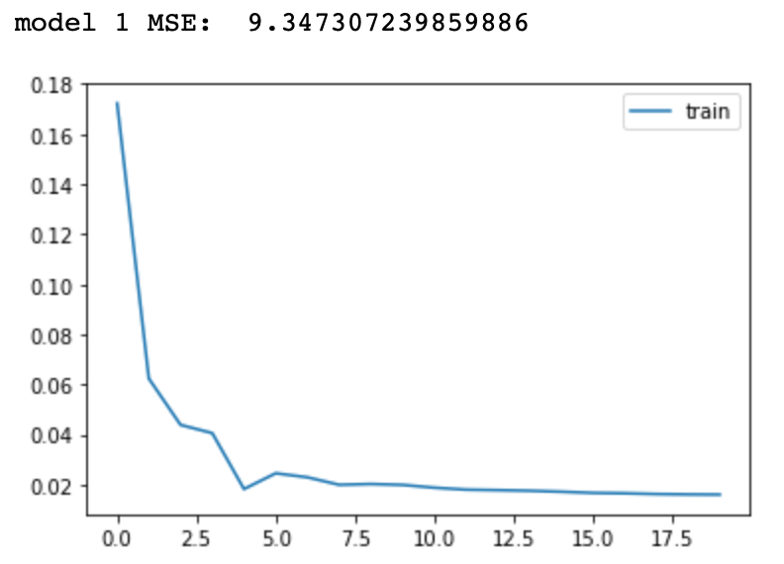
Results with different parameters
Compare different models based on Mean Squared Error (MSE) measure, the simple model with one LSTM layer and one dense layer became the winner with MSE of 9.3, in addition to loss value convergence. When comparing predicted closing price vs actual in the testing data, graphically, they tracks very well.

